Slide 1
List five examples of stored chemical energy.
1
2
3
4
5

Slide 2
List five examples of stored chemical energy.
1 | Batteries | Natural Gas
2 | Petrol | Biomass
3 | Wood | Food
4 | Oil
5 | Coal

Slide 3

Questions
Use the food label shown to answer the following questions about potato soup.
Calculate how many kilojoules of energy are in each serving of potato soup. (HINT: 4.19kilojoules per calorie)

Slide 4
If a person ate the whole container of soup, calculate the chemical energy in kilojoules, they would they receive.

Slide 5


Slide 6
Flow Diagram
Create an energy flow diagram that shows how energy from the Sun is transferred to a person running. Include at least three energy changes in your flow diagram.

Slide 7
Understand fossil fuel energy (a type of chemical energy).
Identify the Sun as a source of radiant energy
Describe how radiant energy is used in photosynthesis
Describe fuels as a form of stored (chemical) energy
Write a paragraph to describe fossil fuels and explain how they were formed.

Slide 8
Fossil fuels contain a type of chemical stored energy.
Examples of fossil fuels include;
Coal
Oil
Natural gas
Fossil fuels are formed from the remains of ancient plants and animals.
During their lifetime, these ancient plants used solar energy during photosynthesis to build carbohydrates.
Animals ate the plants.
When the plants and animals died, and if they had been buried deep inside the Earth for millions of years, heat and pressure may have turned their remains into fossil fuels.
Notes:
Now draw a flow diagram to illustrate this process

Slide 9


Slide 10
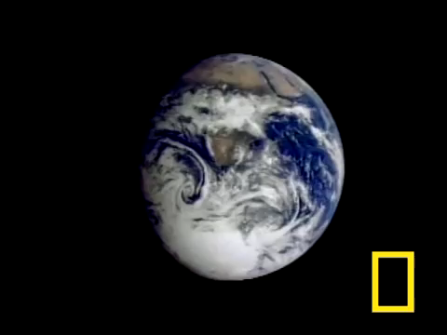

Slide 11
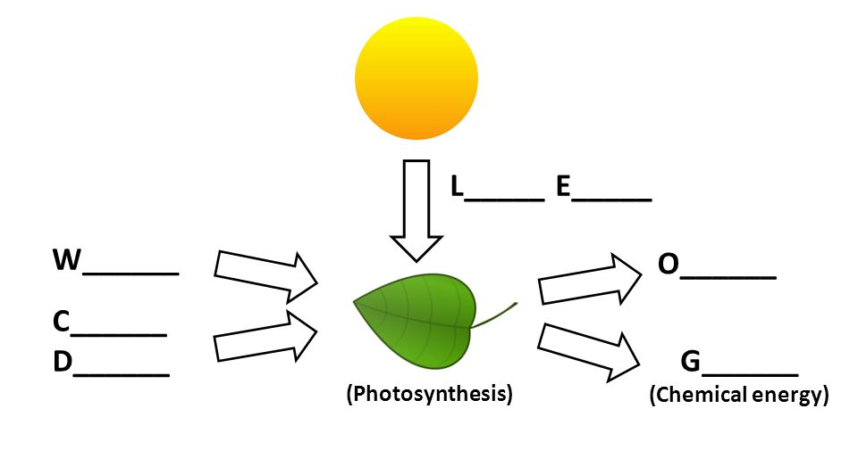
Activity One: Photosynthesis
Complete the diagram below by filling in the missing gaps.

Slide 12
Worksheet answers
A natural fuel such as coal or gas, formed in the geological past from the remains of living organisms.
Coal, Oil and Gas
Heating, Transportation, Electricity
Fossil fuel is a general term for buried combustible geologic deposits of organic materials, formed from decayed plants and animals that have been converted to crude oil, coal, natural gas, or heavy oils by exposure to heat and pressure in the earth's crust over hundreds of millions of years.
Fossil fuels are hydrocarbons comprised primarily of the following elements: carbon and hydrogen and some sulfur, nitrogen, oxygen, and mineral matter. Mineral matter turns into ash when burnt.

Slide 13
Worksheet answers
Although fossil fuels are continually formed by natural processes, they are generally classified as non-renewable resources because they take millions of years to form and known viable reserves are being depleted much faster than new ones are generated
Fossil fuels pollute the environment: Fossil fuels are non-renewable and unsustainable: Drilling for fossil fuels is a dangerous process.
All the energy in oil, gas, and coal originally came from the sun, captured through photosynthesis. In the same way that we burn wood to release energy that trees capture from the sun, we burn fossil fuels to release the energy that ancient plants captured from the sun
Renewable energy: Photovoltaic solar, wind, geothermal, hydroelectric, Thermal salt
Notes:
Carbon emissions contribute to climate change, which can have serious consequences for humans and their environment. ... These carbon emissions raise global temperatures by trapping solar energy in the atmosphere

